Slide 1
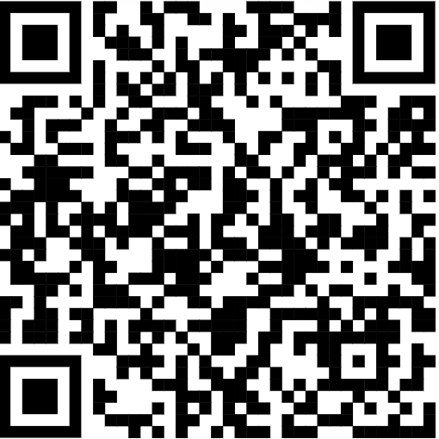
Consulting With Purpose
Please use this QR code to fill out the sign-in form

Slide 2
Notes:
Ben

Slide 3
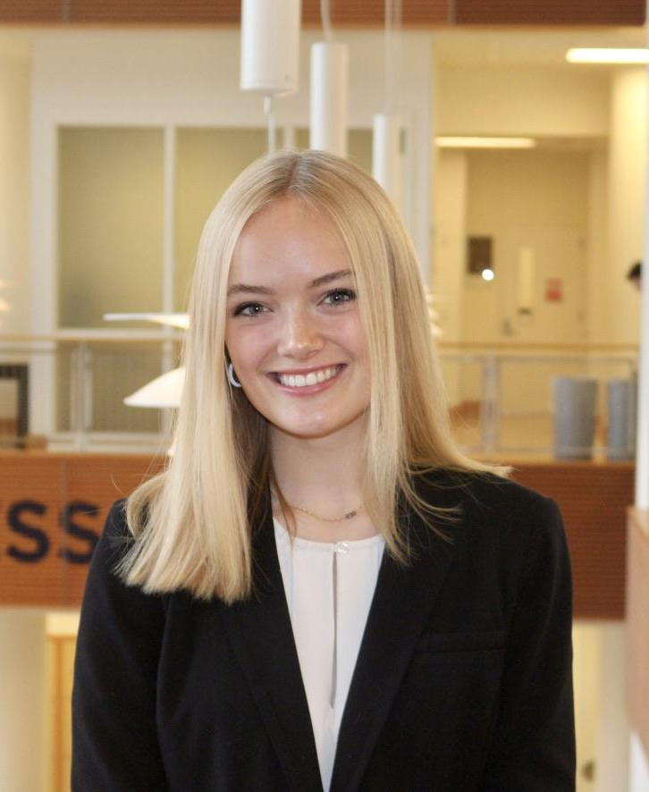
Introductions
Nicola Setterdahl
Managing Partner
Finance
Lauren Cerbin
Managing Partner
Accountancy & Finance
Nandini Gupta
Recruitment Partner
Marketing & Finance
Ben Goebig
Recruitment Partner
Accountancy & IS
Application Process
1
Our Mission
Our Organization
Our Members
Practice Case
Notes:
All

Slide 4
Agenda
1
Our Mission
2
Our Organization
3
Our Members
4
Practice Case
5
Application Process
2
Notes:
Lauren

Slide 5
About Us
SCNO is a student-run consulting organization focusing on providing pro-bono services to nonprofits
Our Mission
SCNO at the University of Illinois provides pro-bono consulting services to nonprofit organizations. With a wide variety of services, we work with these organizations and businesses to develop innovative, practical, and sustainable solutions to challenges.
Our Members
With our selective application process and comprehensive consulting training, our dedicated members are equipped to add value to engagements. Our members have diverse academic backgrounds and technical skills in order to solve a wide variety of issues for our clients.
Application Process
3
Our Mission
Our Organization
Our Members
Practice Case
Notes:
Nicola

Slide 6
Services We Provide
With a wide variety of service offerings, SCNO can solve several business and organizational issues
Organizational Strategy
Process Optimization
Business Development
Sustainability
Step-by-step solutions to big picture problems involving:
Online Advertising
Customer Acquisition
Social Media Utilization
Branding
Target Market Segmentation
Detailed core business analysis involving:
Cost Analysis
Competitor Profiling
Price Optimization
Operational Efficiency
Database Optimization
Long-term planning for:
Market Entry
Sponsorships
New Product Launches
Website Design
Partnerships
Provide guidance through:
Organization Management
Grant Application
Fundraising Recommendations
Platform Utilization
4
Our Mission
Our Organization
Our Members
Practice Case
Application Process
Notes:
Lauren

Slide 7
Our Clients
Who We Serve
We work with nonprofits who have requested consulting services in sustainability, business development, process optimization, and organizational strategy predominantly in the Champaign and Chicagoland area
Our project portfolio includes nonprofit organizations with a wide range of missions, trajectories, and needs
Spring 2024 Portfolio
5
Our Mission
Our Organization
Our Members
Practice Case
Application Process
Notes:
Nicola

Slide 8
Organization Demographics
Our Team
We are a diverse team of students from a variety of academic disciplines and experiences, bound by a passion for nonprofit organizations and making a positive impact on the community
What We Study
How We Perform
6
Our Mission
Our Organization
Our Members
Practice Case
Application Process
Notes:
Lauren

Slide 9
Where Our Alumni Go
Full-Time Placements
7
Our Mission
Our Organization
Our Members
Practice Case
Application Process
Notes:
Nicola

Slide 10
Spring ‘24 Project Manager Spotlight
Snigdha Jangala
Current SCNO Position: Project Manager
Major: Supply Chain Management, Minor in Informatics
Year: Junior
Favorite memory of SCNO? My first semester in the organization when our group had a team social. That night was so much fun and brought me closer to one of my best friends here on campus, Nandini.
8
Our Mission
Our Organization
Our Members
Practice Case
Application Process
Notes:
Nandini

Slide 11
Spring ‘24 New Member Spotlight
Yash Singh
Current SCNO Position: Senior Consultant
Major: Finance and Data Science
Year: Sophomore
Favorite memory of SCNO? My favorite SCNO memory was the banquet at the end of the semester because it was so rewarding to watch everyone celebrate our achievements!
9
Our Mission
Our Organization
Our Members
Practice Case
Application Process
Notes:
Nandini

Slide 12
How to Structure a Case Interview Response
10
Notes:
Nandini

Slide 13
Understanding the Situation
Summarize
Structure
Clarifying Questions
Listen to the entire situation
Take notes
Highlight relevant information
Paraphrase the question
Restate key points
Ask for a moment to organize thoughts (60-90 seconds)
Develop your structure
Walk through your structure with your interviewer
Pinpoint where to start
Verify the objective
Ask any scoping questions
Ask questions about things that weren’t clear
Make sure you have a solid understanding of the case before you move on
11
Our Mission
Our Organization
Our Members
Practice Case
Application Process
Notes:
Nandini

Slide 14
Analyzing the Case
Clear Notes
Quick Math
Charts
Keep your notes organized so that it is easy for you to follow
If you are stuck, the interviewer can help guide you
Solid knowledge of basic math
Quick calculations
Walk interviewer through your process
Explain what you see
Highlight the key points
Note x and y axis
Point out major trends
Comment on any odd findings
Always tie it back to the main question that is being asked
12
Our Mission
Our Organization
Our Members
Practice Case
Application Process
Notes:
Nandini
Always make sure you are prepared with a piece of paper and a pen and are taking clear notes as the interviewer is providing information – whether it be when they introduce the case, provide numbers, or a chart.
Not going to be anything super advanced for the math portion
Add + subract, deal with percentages
Always tie it back to the main question being asked
If you are unsure if your answer is correct just walk interview through your process

Slide 15
Making a Recommendation
Restate the question
SCNO was brought here today to provide an answer for why nonprofit x has seen a lack in donations over the past 2 years, and how to increase that
Provide an answer
Our recommendation is to shift your marketing efforts away from low-income single parent homes to higher income areas of the greater Champaign area
Explain your answer
We went through 4 viable options and identified option 2 would save the most money, reach the most people, and have the largest potential gain in fundraising
Risks
Some risks in this could be losing current donors and taking awhile to see returns
Next Steps
The next steps to take would be re-evaluating your marketing campaign to reach the new target market and forecasting costs in changing efforts
13
Our Mission
Our Organization
Our Members
Practice Case
Application Process
Notes:
Nandini

Slide 16
Practice Case
14
Notes:
Ben

Slide 17
Practice Case
Situation
Our client is Mater, a fictional country located in Eastern Europe with a population of 20 million. The government of Mater wants to make major improvements in both the quantity and quality of education for its children. Because SCNO has a great deal of global knowledge and expertise in the education sector, the Mater department of education has asked SCNO to advise on how it can achieve this transformation of its school system.
Recently, the government of Mater put a new economic plan in place with aspirations to transform its economy and turbocharge its development, so it is well positioned to compete with its European neighbors
Complication
The government of Mater realizes that the education of its children is a critical factor in meeting crucial economic development goals
The nation intends to transform the school system over the next ten years to enable it to support its economic aspirations
Mater’s free market economy is still developing after a period of economic and political instability
The first stage of this effort will involve diagnosing the current state of education in schools in Mater to determine how best to meet the government’s future aspirations
Key Question
SCNO has been asked to support the Mater department of education in diagnosing the state of its current school system, and in identifying the most important areas for improvement.
15
Our Mission
Our Organization
Our Members
Practice Case
Application Process
Notes:
Ben

Slide 18
Question 1
What issues would you want to investigate in diagnosing the current state of the Mater school system? Identify any key metrics you would look at to begin working through the case.
16
Our Mission
Our Organization
Our Members
Practice Case
Application Process
Notes:
Ben

Slide 19
Question 1: Suggested Answer
Key Metrics for Mater
The quantity of education they currently have and how different factors impact it, such as location, age, and demographics
Examples: enrollment levels by location, teacher to student ratios
The quality of education, showed through test scores, teacher backgrounds…
Broader economic metrics, like composition of workforce
17
Our Mission
Our Organization
Our Members
Practice Case
Application Process
Notes:
Ben
Sample Answers
The quantity of available education. What is access to education like, and how does it differ by age, region, and demographic group? What is the supply of teachers and education resources like at a national, regional, or local level? What are the national, regional, and local budgets for education?
The quality of available education. What is the quality of the current curriculum, for example, the subjects taught in schools and levels of attainment or learning objectives? What is the quality of the teaching, for example, the qualification level of teachers or results of teacher assessments?
Mater’s broader economic objectives. What industries and sectors will be a priority for Mater in the future, and what skills will be needed? How well does the current education system develop these skills? Should alternative models to a public education system be considered, for example, independent or private schools?
Metrics:
Sample Answers (will depend based on recruit’s answer to the previous question)
For the quantity of available education: enrollment levels by region/district/city/etc, locations, demographics per school/region, teacher to student ratio, etc.
For the quality of available education: test scores, grades, teacher background, retention, degree completion levels, etc.
For Mater’s broader economic objectives: workforce composition, education levels required for various occupations, working class income, etc.

Slide 20
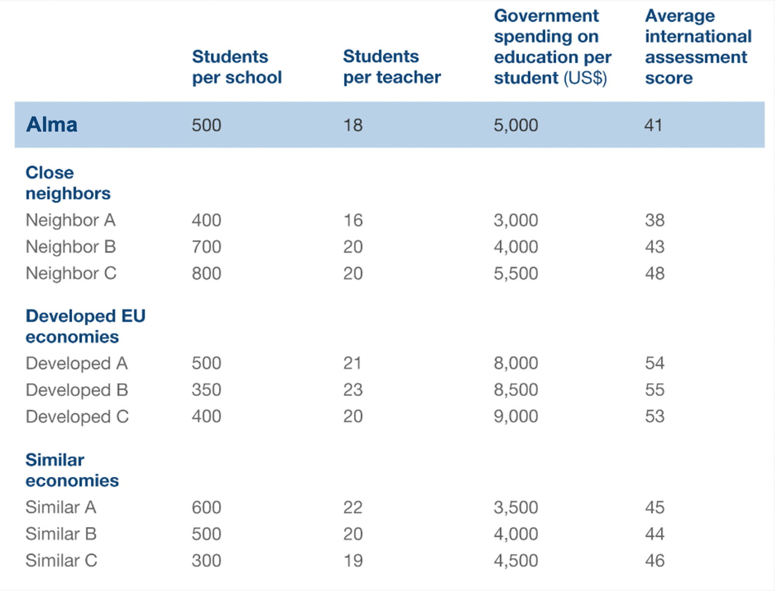
Question 2
The chart you have been given shows some important education-related measures for Mater and also for some comparison countries. Three sets of comparison countries have been used. The first set contains some of Mater’s neighboring countries in Eastern Europe. In the second set are some of the most developed economies in Europe. Finally, in the third set are some countries that have similar sized economies to Mater on a per person basis, which have similar GDP per capita.
What observations can you derive from this chart?
Mater
18
Our Mission
Our Organization
Our Members
Practice Case
Application Process
Notes:
Ben
Sample Answers
Mater spends more on education and also has a lower student-to-teacher ratio than the majority of its neighbors and economic peers, however, despite these factors, Mater still has one of the lowest international assessment scores.
Broadly, there seems to be no direct relationship between student-to-teacher ratio and education outcome as measured by the international assessment.
Developed countries clearly spend more per student on education and have better outcomes as measured by the international assessment. However, among Mater’s peers and neighbors there is no clear relationship between spending and education outcomes.
While student-to-teacher ratios and per-student funding are levers that could be important in improving education quality, the data here indicates that alone, these may not deliver the necessary improvements. Issues such as teacher quality and curriculum content should be investigated.

Slide 22
Question 2: Suggested Answer
Economic Peers & Neighbors
Developed EU Economies
Mater spends more on education and has a lower student-to-teacher ratio despite still having some of the lowest scores
No direct relationship between these two factors and assessment scores
Students per school shows a negative correlation, but doesn’t continue with other country comparisons
Developed countries spending significantly more on education with better assessment scores
Levers like spending, student-to-teacher ratios, etc. could have impacts in education quality, but may not deliver the necessary improvements alone
19
Our Mission
Our Organization
Our Members
Practice Case
Application Process
Notes:
Ben
Sample Answers
Mater spends more on education and also has a lower student-to-teacher ratio than the majority of its neighbors and economic peers, however, despite these factors, Mater still has one of the lowest international assessment scores.
Broadly, there seems to be no direct relationship between student-to-teacher ratio and education outcome as measured by the international assessment.
Developed countries clearly spend more per student on education and have better outcomes as measured by the international assessment. However, among Mater’s peers and neighbors there is no clear relationship between spending and education outcomes.
While student-to-teacher ratios and per-student funding are levers that could be important in improving education quality, the data here indicates that alone, these may not deliver the necessary improvements. Issues such as teacher quality and curriculum content should be investigated.

Slide 23
Question 3A
Continuing with the table you have been given, one of the clients at Mater’s educational department mentions neighbor country “C” as an example, because it is outperforming all of Mater’s economic peers and neighbors in the international assessment. She suggests that having larger, less fragmented schools allows for more effective teacher selection and training, leading to improved education outcomes for students. Finally, she shares that there are three million school children and 6,000 schools across Mater, allowing for 500 students per school. Assuming Mater wants the same number of students per school as neighbor C (800), how many schools would Mater have to have?
20
Our Mission
Our Organization
Our Members
Practice Case
Application Process
Notes:
Nandini
Sample Answers
Assuming the same school size as neighbor C would mean there are 3,750 schools across Mater (3 million divided by 800 students)

Slide 24
Question 3A: Suggested Answer
To calculate this…
Take 6,000 schools in Mater * 500 students per school = 3 million students total
To find the number of schools take the 3 million students and divide by 800 students (neighbor C) to get = 3,750 schools
Our Mission
Our Organization
Our Members
Practice Case
Application Process
Notes:
Nandini

Slide 25
Question 3B
Based on the calculations in part A, what would be the reduction in the total number of schools in Mater if it were to achieve the same average school size as neighbor country C?
21
Our Mission
Our Organization
Our Members
Practice Case
Application Process
Notes:
Nandini
Sample Answers
Therefore, 2,250 schools would be closed—or about 37.5 percent of schools : solved by 6,000 - 3,750

Slide 26
Question 3B: Suggested Answer
2,250 schools would be closed—or about 37.5 percent of schools : solved by 6,000 - 3,750
Our Mission
Our Organization
Our Members
Practice Case
Application Process
Notes:
Nandini

Slide 27
Question 4
Based on the current state of the school system and the information that you have been provided, your client would like to hear your final recommendation regarding Mater’s most important areas for improvement and the initial actions to be taken.
22
Our Mission
Our Organization
Our Members
Practice Case
Application Process
Notes:
Ben
Technically no “wrong” answer: based on Q4, suggest fewer schools with larger class sizes ; continue comparing system to successful countries’ school systems, increase/decrease spending
Encourage them to explain their “whys” for the recommendations instead of just giving an answer with no explanations
Does the recruit mention next steps, risks & mitigations?
- Future trends, what will happen if Mater becomes more developed, etc

Slide 28
Question 4: Suggested Answer
Larger class sizes with fewer schools
Continue to compare system to successful countries & their metrics
Increase spending per student on education
23
Our Mission
Our Organization
Our Members
Practice Case
Application Process
Notes:
Ben
Technically no “wrong” answer: based on Q4, suggest fewer schools with larger class sizes ; continue comparing system to successful countries’ school systems, increase/decrease spending
Encourage them to explain their “whys” for the recommendations instead of just giving an answer with no explanations
Does the recruit mention next steps, risks & mitigations?
- Future trends, what will happen if Mater becomes more developed, etc

Slide 29
Tips for a Strong Recommendation
Provide a clear recommendation first
Back up recommendation with findings from the case
Consider any risks to the suggested recommendation & ways to mitigate these risks
Outline next steps in research to solidify the recommendation
24
Our Mission
Our Organization
Our Members
Practice Case
Application Process
Notes:
Ben

Slide 30
Application Process
Info Night
About Us and Case Workshop
Pre Night*
Networking
January 23rd
@ 6pm
January 26th
@ 11:59 pm
January 28th
@ 7:30 or 8:30pm (by time slot)
January 31st and Feb 1st
Application Deadline
Available at illiniscno.org and in the Instagram bio
Interviews*
Case and Behavioral
*Invite Only
25
Our Mission
Our Organization
Our Members
Practice Case
Application Process
Notes:
Ben

Slide 31
Thank you for coming!
Notes:
Ben

Slide 32
Consulting With Purpose
Please use this QR code to fill out the sign-in form
Notes:
Updated for Fall 2023!

