Slide 1
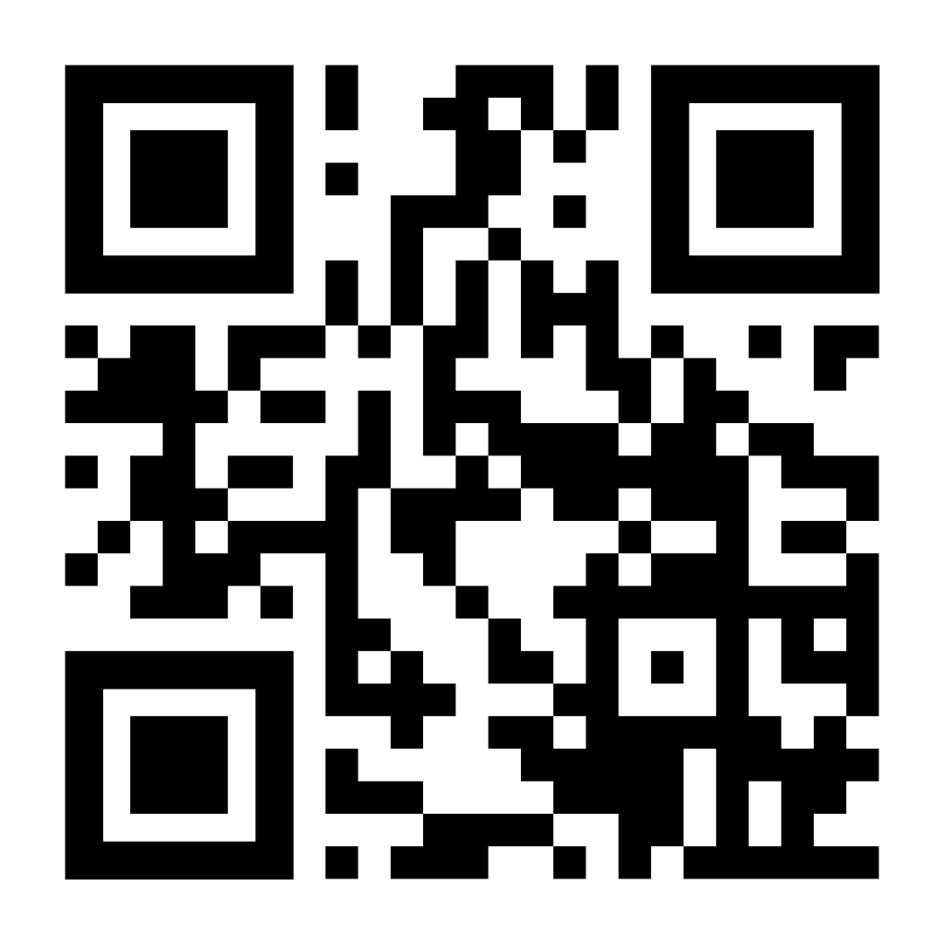

Consulting With Purpose
Please use this QR code to fill out the sign-in form
Notes:
updated QR code

Slide 2

Notes:
Hello everyone and welcome to SCNOs Fall 2025 Info Night! We’re very excited to have you all here and talk to you about this amazing organization.

Slide 3
Agenda
1
Our Mission
2
Our Members
3
Our Organization
4
Case Interview Tips & Practice Case
5
Application Process
Notes:
Will
Today we’re going to go over a little bit about…
But first, we want to take a moment to introduce ourselves!

Slide 4
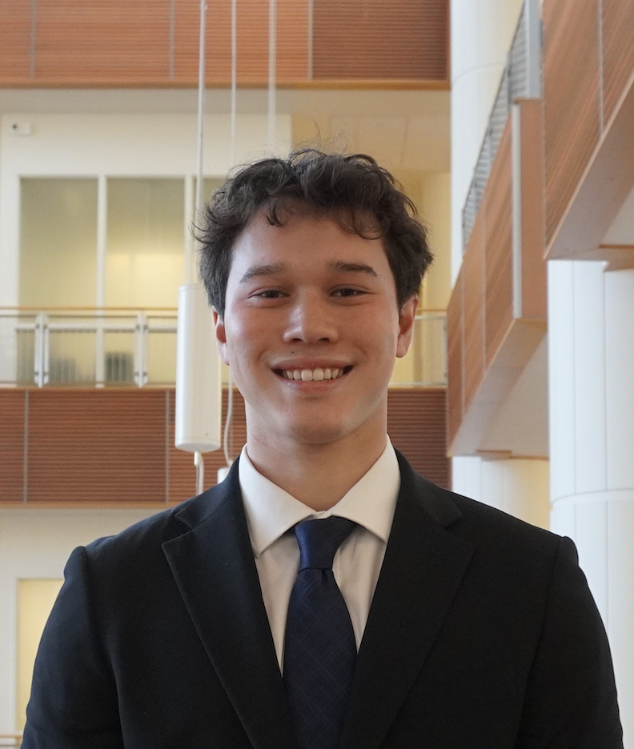
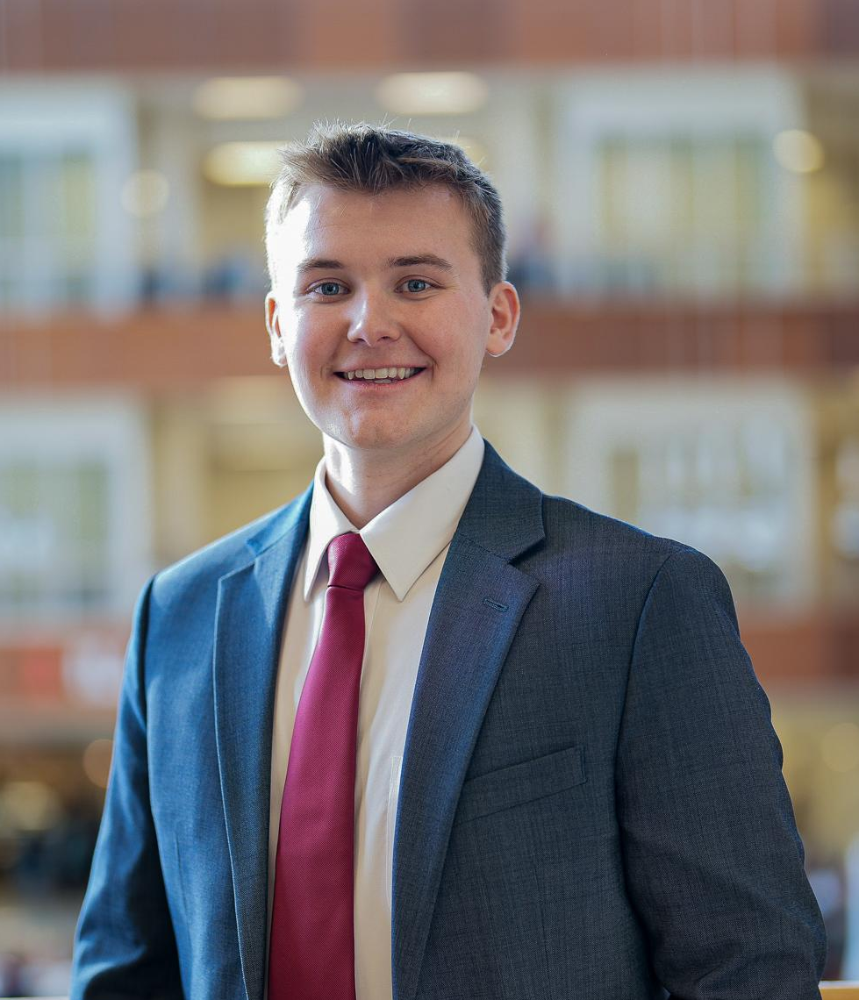
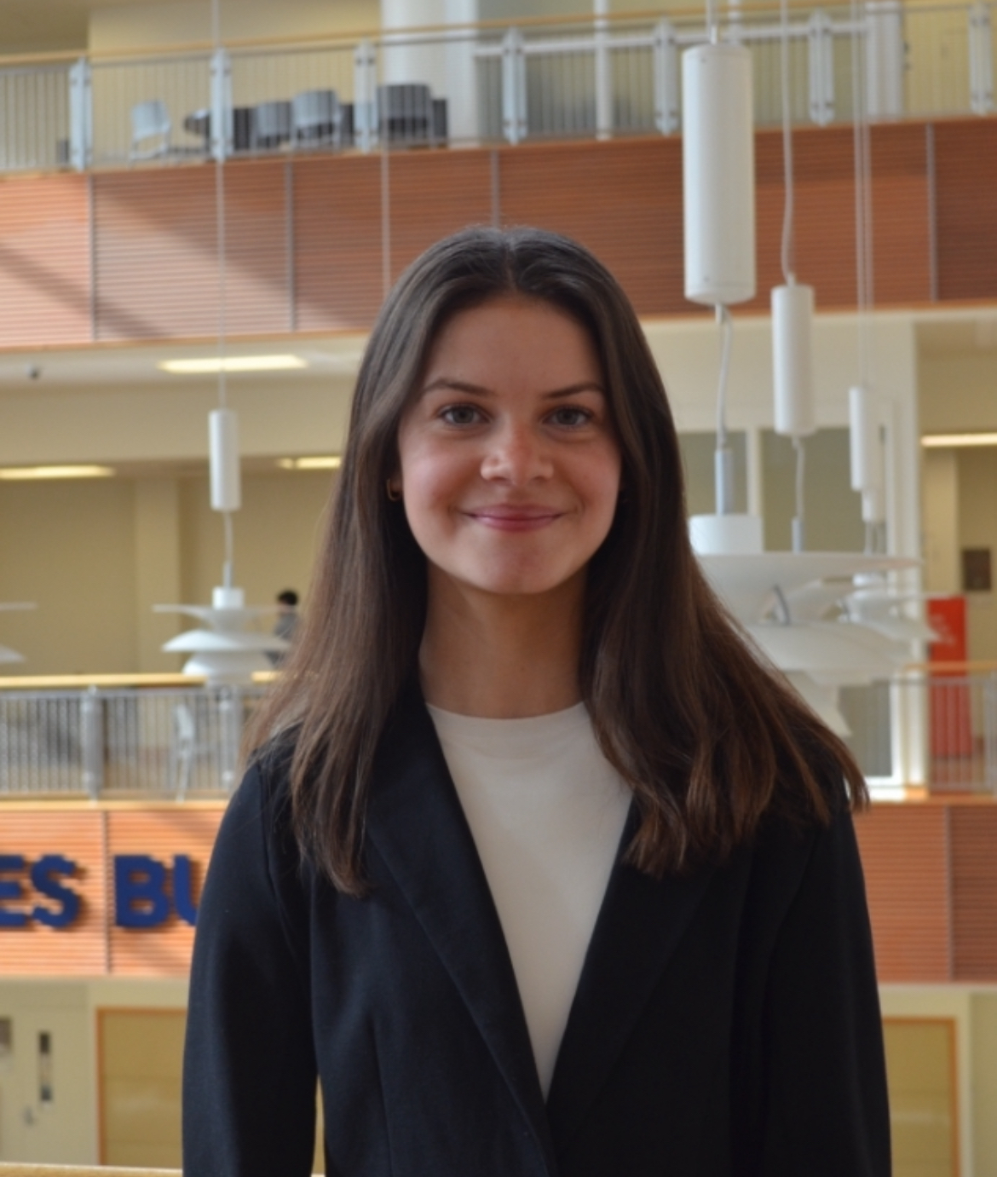
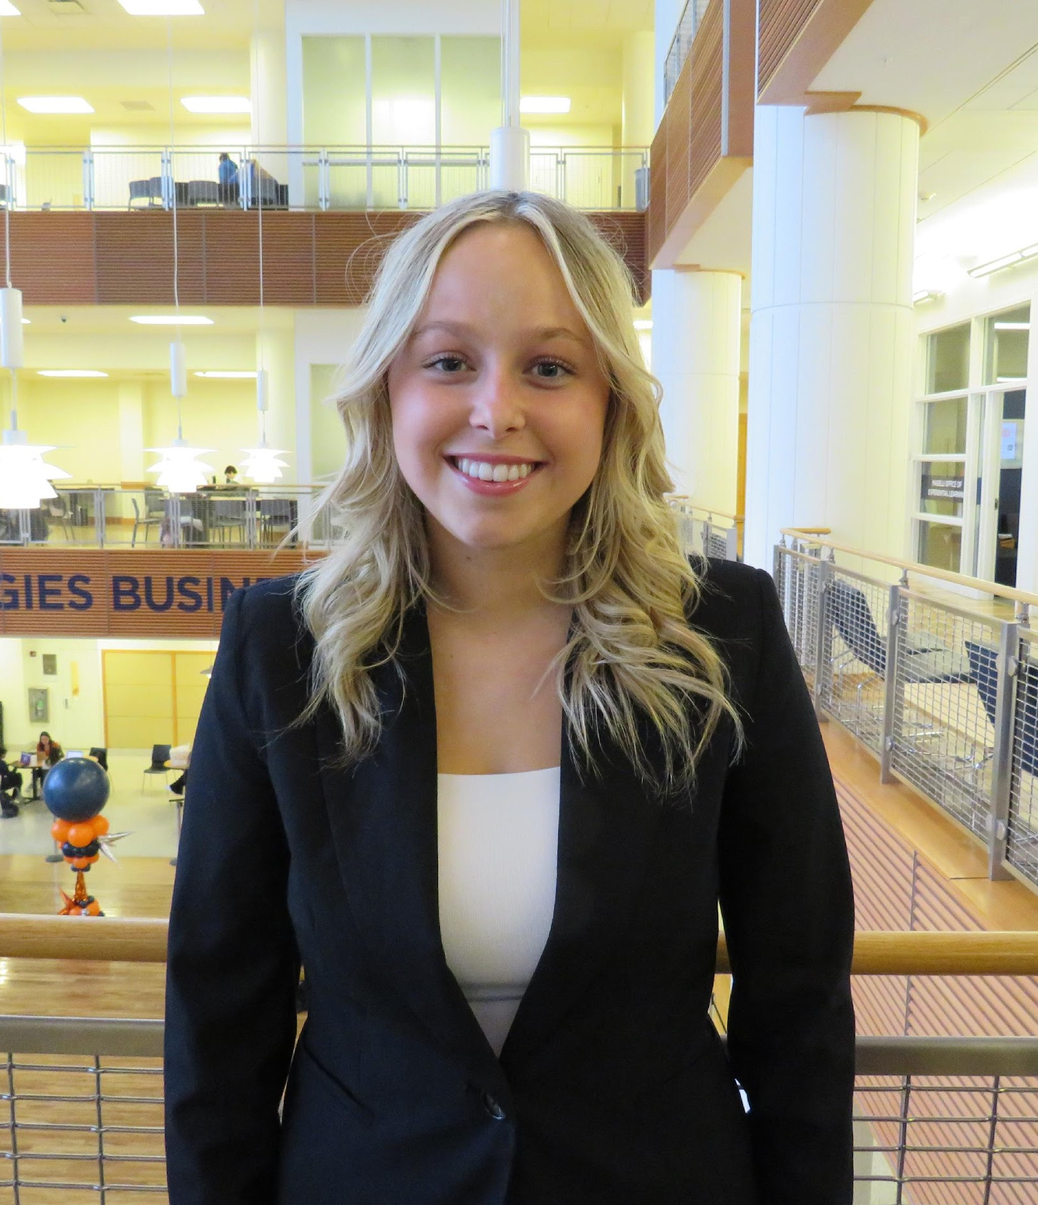
Introductions
Will Geiger
Managing Partner
Finance
Matthew Roalkvam
Managing Partner
Accountancy & Finance
Bridget Pekar
Recruitment Partner
Marketing & Management
Emma Sauers
Recruitment Partner
Marketing & IS
Notes:
Intro ur self
Emma: “Now I’ll pass it off to Matthew to talk about our mission”

Slide 5

About Us
SCNO is a student-run consulting organization focusing on providing pro-bono services to nonprofits
Our Mission
    SCNO at the University of Illinois provides pro-bono consulting services to nonprofit organizations. With a wide variety of services, we work with these organizations and businesses to develop innovative, practical, and sustainable solutions to challenges.
Our Members
    With our selective application process and comprehensive consulting training, our dedicated members are equipped to add value to engagements. Our members have diverse academic backgrounds and technical skills in order to solve a wide variety of issues for our clients.
Notes:
Matthew
SCNO is One of the largest consulting orgs on campus, we provide pro-bono consulting services to nonprofits, adding our member’s unique skill sets to the challenges faced by our clients. Through our trainings we will equip you to solve those challenges and apply what you’ve learned to future clients.

Slide 6
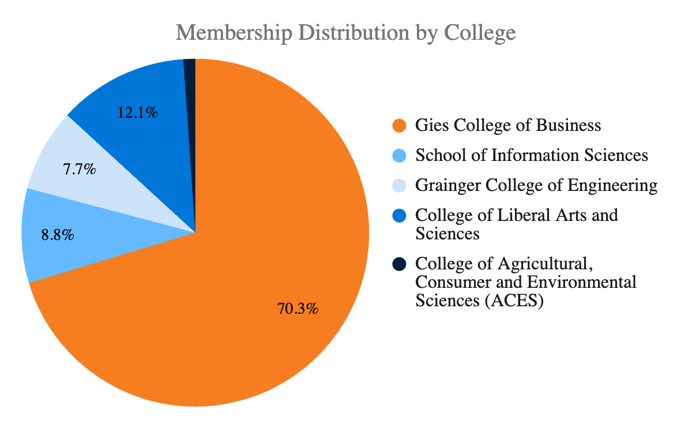
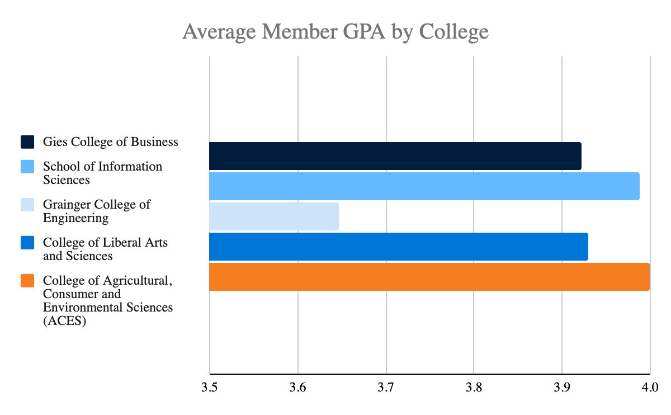
Organization Demographics
Our Team
We are a diverse team of students from a variety of academic disciplines and experiences, bound by a passion for nonprofit organizations and making a positive impact on the community
What We Study
How We Perform
Notes:
Updated visuals

Slide 7

























Where Our Alumni Go
Full-Time Placements
Notes:
Matthew
As you might expect we have placements in many consulting firms, like:
All of the BIG 3 Consulting firms
All of the Big 4
And many other boutique firms as well

Slide 8
















Our Clients
Who We Serve
We work with nonprofits who have requested consulting services in sustainability, business development, process optimization, and organizational strategy predominantly in the Champaign and Chicagoland area
Our project portfolio includes nonprofit organizations with a wide range of missions, trajectories, and needs
Spring 2026 Portfolio
We have projects that spread over 9
different Non-Profit functions
Our projects span over 10 different cities in multiple countries
Our projects have workstreams in 15 different developmental areas
Notes:
Will
With the help of our client relations partners: Gautham and Sohi, we were able to put together an incredible project portfolio for this semester
On the left hand side here are some of the 14 nonprofits we will be working with this semester: some returning clients, and some new!
Our client portfolio spreads across over 6 different functions, and operates in 10 cities in multiple countries
We also have over 14 developmental areas where we will be focousing our work this semester, meaning that whatever you are looking for whether it’s a specific nonprofit need or area you want to develop in we have it

Slide 9
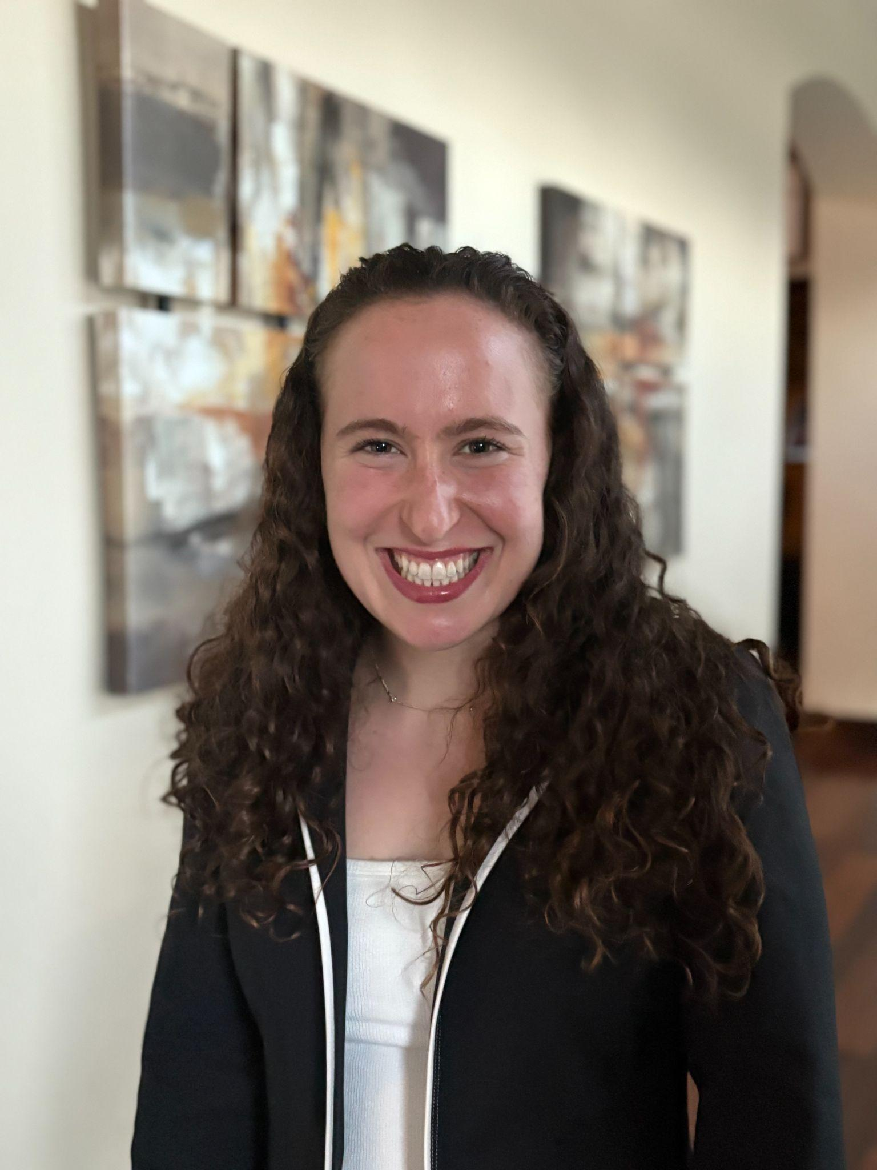
Fall ‘25 Project Manager Spotlight
Sophia Libman
Current SCNO Position: Client Relations Lead
Major: Finance & Strategy, Innovation, and Entrepreneurship
Year: Sophomore
Favorite memory of SCNO? Project kick-off last semester, meeting all the new members and my project team. The SCNO community is what makes the organization so special!
Notes:
Will (?) introduce Sophia

Slide 10




Services We Provide
With a wide variety of service offerings, SCNO can solve several business and organizational issues
Organizational Strategy
Process Optimization
Business Development
Sustainability
Step-by-step solutions to big picture problems involving:
Online Advertising
Customer Acquisition
Social Media Utilization
Branding
Target Market Segmentation
Detailed core business analysis involving:
Cost Analysis
Competitor Profiling
Price Optimization
Operational Efficiency
Database Optimization
Long-term planning for:
Market Entry
Sponsorships
New Product Launches
Website Design
Partnerships
Provide guidance through:
Organization Management
Grant Application
Fundraising Recommendations
Platform Utilization
Notes:
Matthew
SCNO project take on a wide variety of forms – often including multiple facets.
Some of our most common projects revolve around social media management, grant application strategies, and volunteer retention
but every project is unique – each client requires a tailored solution to their problem – you’ll always be working on something new

Slide 11




What is a Project?
Consulting
Workstreams
Deliverables
Structure
Consulting is when clients come to us with a “business problem”
We take those problems and perform research and create recommendations based on those research
As a consultant you will handle a “workstream”
This is when a client project is broken into different parts for consultants to work on
Each project team has around
6 – 7 members
There will be 1 Partner, 1 PM, 1 SC, and anywhere from 3 - 4 Consultants
During a semester you and your team will present to the client twice
These presentations will be a compilation of your research and recommendations
Notes:
Will
So, now we’ll look at what a typical project will look like.

Slide 12





What We Offer
Training
Professional
Socials
Philanthropy
Miscellaneous
Teach the foundational consulting skills
Learn vital business skills for career development
Build genuine friendships
Connect with your project team
Other opportunities meant to help you develop
Slide design training, public speaking workshops
Corporate events, resume reviews, case workshops
Team socials, new member events, barn dances
DREAAM, Salt & Light, Card making, kickball
Alumni connections & Leadership Opportunities
Notes:
Matthew
Throughout your New Member semester, we offer comprehensive trainings on all the topics you’ll need to succeed : powerpoint , researching tips, team communication
We host professional events with company reps to talk about your next steps after college
AS well we also have Social and Philanthropy events to round out your experience in SCNO

Slide 13
Consultant Week in the Life
A potential overview of your week as a New Member in SCNO
Client Meeting
Receive Feedback
Break Day
Mon
Tue
Wed
Thu
Fri
Sat
Sun
Team Meeting (Client Updates, Weekly Workstreams)
Workstreams Due (Slides / White pages)
Slide Feedback Due
New Member Training :)
Notes:
Will
This is an outline of what a week in your life could look like,
Explain each week,
Very manageable, it is what you put into it, each team looks a little different
Now I will pass it off to Leeza, a sophomore studying Earth, Society, and Environmental Sustainability. Leeza was a new member last semester and she’s going to tell you a little bit about her experience in SCNO!

Slide 14
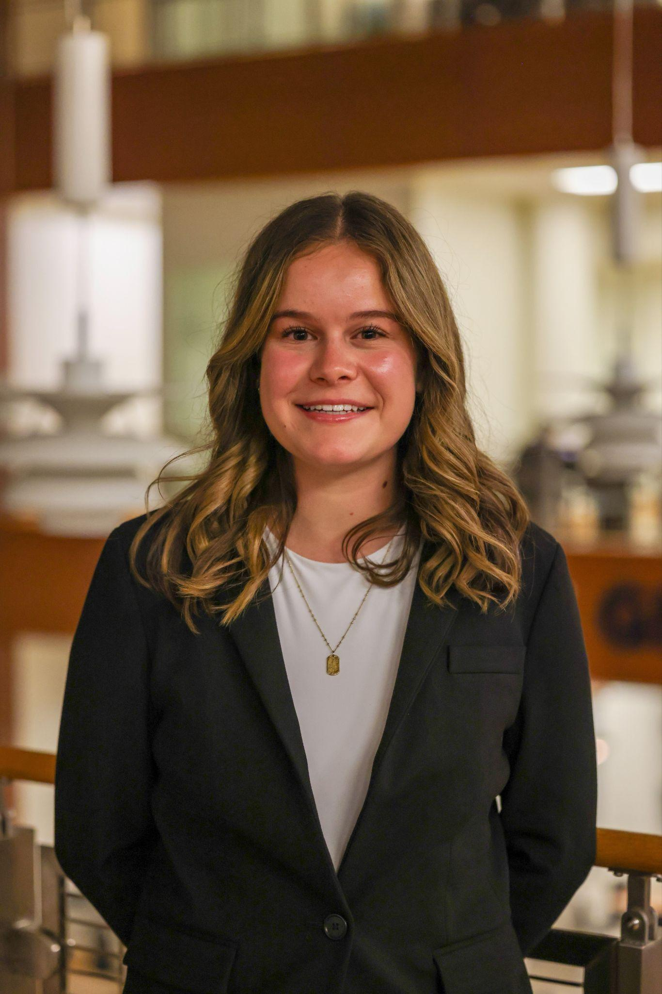
Fall ‘25 New Member Spotlight
Caroline Ozturk
Current SCNO Position: Senior Consultant
Major: Accountancy + Data Science
Year: Sophomore
Favorite memory of SCNO? Team Social @ Cocomero!
Notes:
Will introduce _____

Slide 15
How to Structure a Case Interview Response
Notes:
Matthew
- Make sure to talk about the interview process and the fact that we do both a behavioral and case interview

Slide 16



Understanding the Situation
Summarize
Clarifying Questions
Structure
Listen to the entire situation
Take notes
Highlight relevant information
Paraphrase the question
Restate key points
Verify the objective
Ask any scoping questions
Ask questions about things that weren’t clear
Make sure you have a solid understanding of the case before you move on
Ask for a moment to organize thoughts (60-90 seconds)
Develop your structure
Walk through your structure with your interviewer
Pinpoint where to start
Notes:
Matthew

Slide 17



Analyzing the Case
Clear Notes
Quick Math
Charts
Keep your notes organized so that it is easy for you to follow
If you are stuck, the interviewer can help guide you
Bring paper and a pen
Solid knowledge of basic math
Quick calculations
Walk interviewer through your process
Explain what you see
Highlight the key points
Note x and y axis
Point out major trends
Comment on any odd findings
Always tie it back to the main question that is being asked
Notes:
Will
Always make sure you are prepared with a piece of paper and a pen and are taking clear and concise notes as the interviewer is providing information – whether it be when they introduce the case, provide numbers, or a chart. Do not be afraid to ask the interviewer for help. They can help guide you as you work through the case.
Not going to be anything super advanced for the math portion
Add + subtract, deal with percentages
Always tie it back to the main question being asked
If you are unsure if your answer is correct just walk the interviewer through your thinking and problem-solving process

Slide 18
Making a Recommendation
Recap
SCNO was brought here today to provide an answer for why nonprofit x has seen a lack in donations over the past 2 years, and how to increase that
Recap
An overview of the client and a quick synopsis of the problem you worked to solve
Recommendation
Our recommendation is to shift your marketing efforts away from low-income single parent homes to higher income areas of the greater Champaign area
Recommendation
A clear statement telling the client your solution to their problem
Reasoning
Reasoning
We went through 4 viable options and identified option 2 would save the most money, reach the most people, and have the largest potential gain in fundraising
Two to three pieces of evidence you have gathered from the case based on your exhibits and analysis
Risks & Mitigations*
Risks & Mitigations
Some risks in this could be losing current donors and taking awhile to see returns
One to two things that are potential barriers to your recommendation and solutions to fix them
Road Map*
Road Map
The next steps to take would be re-evaluating your marketing campaign to reach the new target market and forecasting costs in changing efforts
Immediate next steps the client should take in order to take the recommendations and begin implementing them
Notes:
Matthew

Slide 19
Practice Case
Notes:
Bridget
“Now Emma and I will walk you through a practice case similar to the one you’d see in our case interview”

Slide 20
Background
Situation
Our client is Mater, a fictional country located in Eastern Europe with a population of 20 million. The government of Mater wants to make major improvements in both the quantity and quality of education for its children. Because SCNO has a great deal of global knowledge and expertise in the education sector, the Mater department of education has asked SCNO to advise on how it can achieve this transformation of its school system.
Recently, the government of Mater put a new economic plan in place with aspirations to transform its economy and turbocharge its development, so it is well positioned to compete with its European neighbors
Complication
The government of Mater realizes that the education of its children is a critical factor in meeting crucial economic development goals
The nation intends to transform the school system over the next ten years to enable it to support its economic aspirations
Mater’s free market economy is still developing after a period of economic and political instability
The first stage of this effort will involve diagnosing the current state of education in schools in Mater to determine how best to meet the government’s future aspirations
Key Question
SCNO has been asked to support the Mater department of education in diagnosing the state of its current school system, and in identifying the most important areas for improvement.
20
Our Mission
Our Organization
Our Members
Practice Case
Application Process
Notes:
Bridget

Slide 21
Question 1
What issues would you want to investigate in diagnosing the current state of the Mater school system? Identify any key metrics you would look at to begin working through the case.
21
Our Mission
Our Organization
Our Members
Practice Case
Application Process
Notes:
Bridget

Slide 22
Question 1: Suggested Answer
Key Metrics for Mater
The quantity of education they currently have and how different factors impact it, such as location, age, and demographics
  Examples: enrollment levels by location, teacher to student ratios
The quality of education, showed through test scores, teacher backgrounds…
Broader economic metrics, like composition of workforce
22
Our Mission
Our Organization
Our Members
Practice Case
Application Process
Notes:
Bridget
Sample Answers
The quantity of available education. What is access to education like, and how does it differ by age, region, and demographic group? What is the supply of teachers and education resources like at a national, regional, or local level? What are the national, regional, and local budgets for education?
The quality of available education. What is the quality of the current curriculum, for example, the subjects taught in schools and levels of attainment or learning objectives? What is the quality of the teaching, for example, the qualification level of teachers or results of teacher assessments?
Mater’s broader economic objectives. What industries and sectors will be a priority for Mater in the future, and what skills will be needed? How well does the current education system develop these skills? Should alternative models to a public education system be considered, for example, independent or private schools?
Metrics:
Sample Answers (will depend based on recruit’s answer to the previous question)
For the quantity of available education: enrollment levels by region/district/city/etc, locations, demographics per school/region, teacher to student ratio, etc.
For the quality of available education: test scores, grades, teacher background, retention, degree completion levels, etc.
For Mater’s broader economic objectives: workforce composition, education levels required for various occupations, working class income, etc.

Slide 23
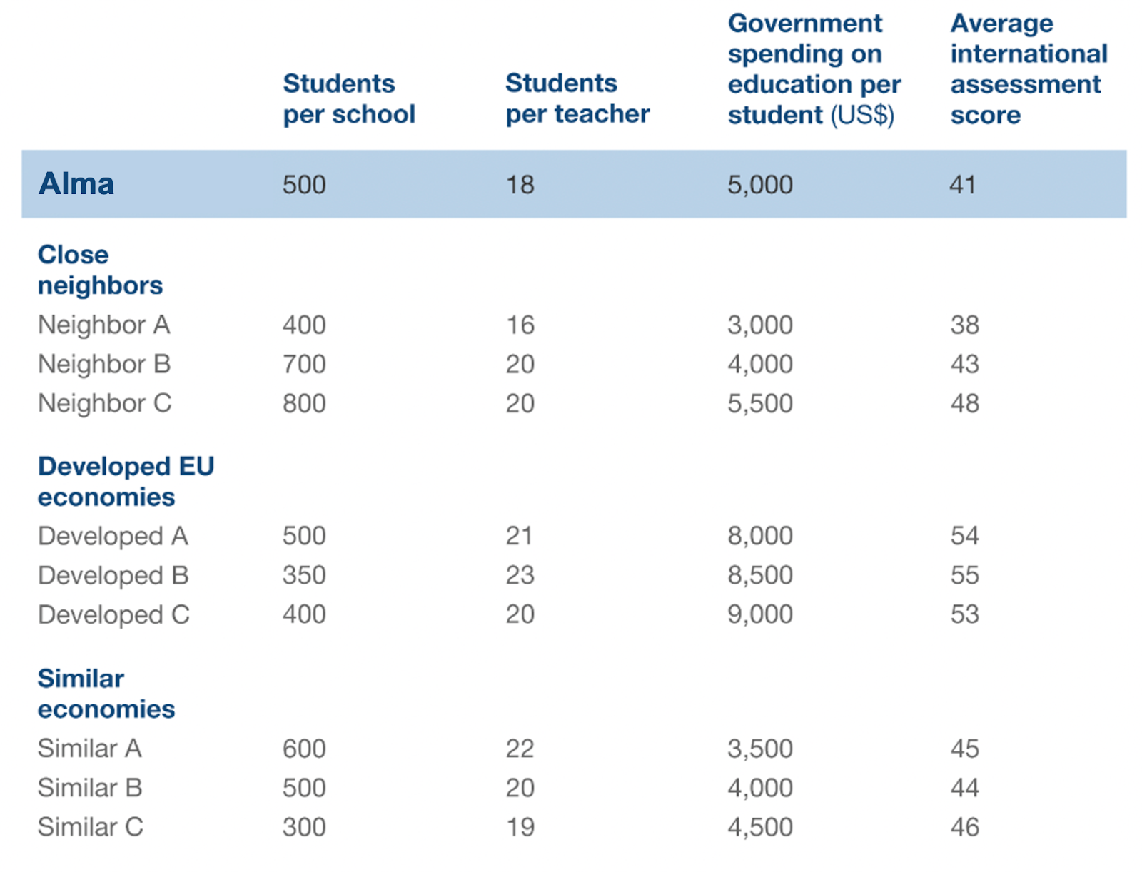
Question 2
The chart you have been given shows some important education-related measures for Mater and also for some comparison countries. Three sets of comparison countries have been used. The first set contains some of Mater’s neighboring countries in Eastern Europe. In the second set are some of the most developed economies in Europe. Finally, in the third set are some countries that have similar sized economies to Mater on a per person basis, which have similar GDP per capita.
What observations can you derive from this chart?
Mater
23
Our Mission
Our Organization
Our Members
Practice Case
Application Process
Notes:
Emma
Sample Answers
Mater spends more on education and also has a lower student-to-teacher ratio than the majority of its neighbors and economic peers, however, despite these factors, Mater still has one of the lowest international assessment scores.
Broadly, there seems to be no direct relationship between student-to-teacher ratio and education outcome as measured by the international assessment.
Developed countries clearly spend more per student on education and have better outcomes as measured by the international assessment. However, among Mater’s peers and neighbors there is no clear relationship between spending and education outcomes.
While student-to-teacher ratios and per-student funding are levers that could be important in improving education quality, the data here indicates that alone, these may not deliver the necessary improvements. Issues such as teacher quality and curriculum content should be investigated.

Slide 24
Mater
Notes:
Emma

Slide 25
Question 2: Suggested Answer
Economic Peers & Neighbors
Developed EU Economies
Mater spends more on education and has a lower student-to-teacher ratio despite still having some of the lowest scores
No direct relationship between student-to-teacher ratio and education outcome as measured by the assessment
Students per school shows a negative correlation, but doesn’t continue with other country comparisons
Developed countries spending significantly more on education with better assessment scores
Levers like spending, student-to-teacher ratios, etc. could have impacts in education quality, but may not deliver the necessary improvements alone
25
Our Mission
Our Organization
Our Members
Practice Case
Application Process
Notes:
Emma
Sample Answers
Mater spends more on education and also has a lower student-to-teacher ratio than the majority of its neighbors and economic peers, however, despite these factors, Mater still has one of the lowest international assessment scores.
Broadly, there seems to be no direct relationship between student-to-teacher ratio and education outcome as measured by the international assessment.
Developed countries clearly spend more per student on education and have better outcomes as measured by the international assessment. However, among Mater’s peers and neighbors there is no clear relationship between spending and education outcomes.
While student-to-teacher ratios and per-student funding are levers that could be important in improving education quality, the data here indicates that alone, these may not deliver the necessary improvements. Issues such as teacher quality and curriculum content should be investigated.

Slide 26
Question 3A
Continuing with the table you have been given, one of the clients at Mater’s educational department mentions neighbor country “C” as an example, because it is outperforming all of Mater’s economic peers and neighbors in the international assessment. She suggests that having larger, less fragmented schools allows for more effective teacher selection and training, leading to improved education outcomes for students. Finally, she shares that there are three million school children and 6,000 schools across Mater, allowing for 500 students per school. Assuming Mater wants the same number of students per school as neighbor C (800), how many schools would Mater have to have?
26
Our Mission
Our Organization
Our Members
Practice Case
Application Process
Notes:
Bridget
Sample Answers
Assuming the same school size as neighbor C would mean there are 3,750 schools across Mater (3 million divided by 800 students)

Slide 27
Question 3A: Suggested Answer
To calculate this…
Take 6,000 schools in Mater * 500 students per school = 3 million students total
To find the number of schools take the 3 million students and divide by 800 students (neighbor C) to get = 3,750 schools
27
Our Mission
Our Organization
Our Members
Practice Case
Application Process
Notes:
Bridget

Slide 28
Question 3B
Based on the calculations in part A, what would be the reduction in the total number of schools in Mater if it were to achieve the same average school size as neighbor country C?
28
Our Mission
Our Organization
Our Members
Practice Case
Application Process
Notes:
Bridget
Sample Answers
Therefore, 2,250 schools would be closed—or about 37.5 percent of schools : solved by 6,000 - 3,750

Slide 29
Question 3B: Suggested Answer
2,250 schools would be closed—or about 37.5 percent of schools : solved by 6,000 - 3,750
29
Our Mission
Our Organization
Our Members
Practice Case
Application Process
Notes:
Bridget

Slide 30
Question 4
Based on the current state of the school system and the information that you have been provided, your client would like to hear your final recommendation regarding Mater’s most important areas for improvement and the initial actions to be taken.
30
Our Mission
Our Organization
Our Members
Practice Case
Application Process
Notes:
Emma
Technically no “wrong” answer: based on Q4, suggest fewer schools with larger class sizes ; continue comparing system to successful countries’ school systems, increase/decrease spending
Encourage them to explain their “whys” for the recommendations instead of just giving an answer with no explanations
Does the recruit mention next steps, risks & mitigations?
- Future trends, what will happen if Mater becomes more developed, etc

Slide 31



Question 4: Suggested Answer
Larger class sizes with fewer schools
Continue to compare system to successful countries & their metrics
      Increase spending per student on education
31
Our Mission
Our Organization
Our Members
Practice Case
Application Process
Notes:
Emma
Technically no “wrong” answer: based on Q4, suggest fewer schools with larger class sizes ; continue comparing system to successful countries’ school systems, increase/decrease spending
Encourage them to explain their “whys” for the recommendations instead of just giving an answer with no explanations
Does the recruit mention next steps, risks & mitigations?
- Future trends, what will happen if Mater becomes more developed, etc

Slide 32
Tips for a Strong Recommendation
Provide a clear recommendation first
Back up recommendation with findings from the case
Consider any risks to the suggested recommendation & ways to mitigate these risks
Outline next steps in research to solidify the recommendation
32
Our Mission
Our Organization
Our Members
Practice Case
Application Process
Notes:
Bridget

Slide 33
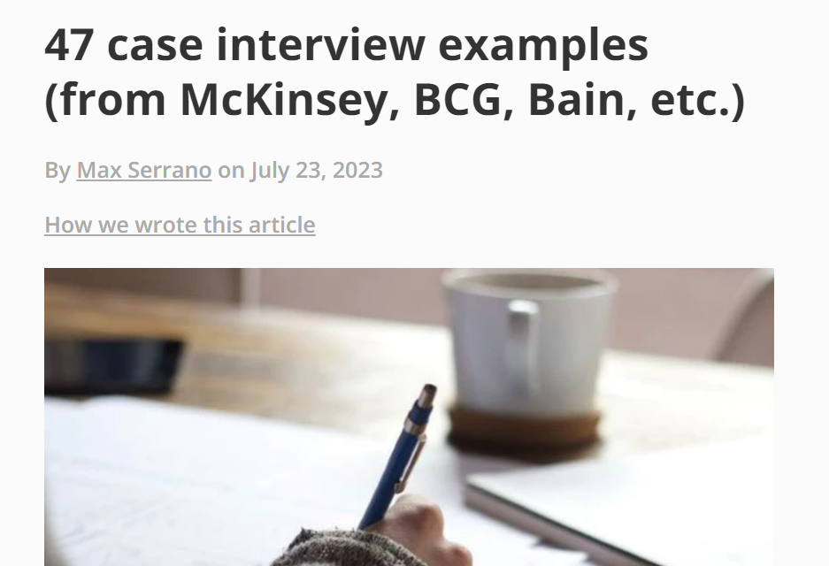
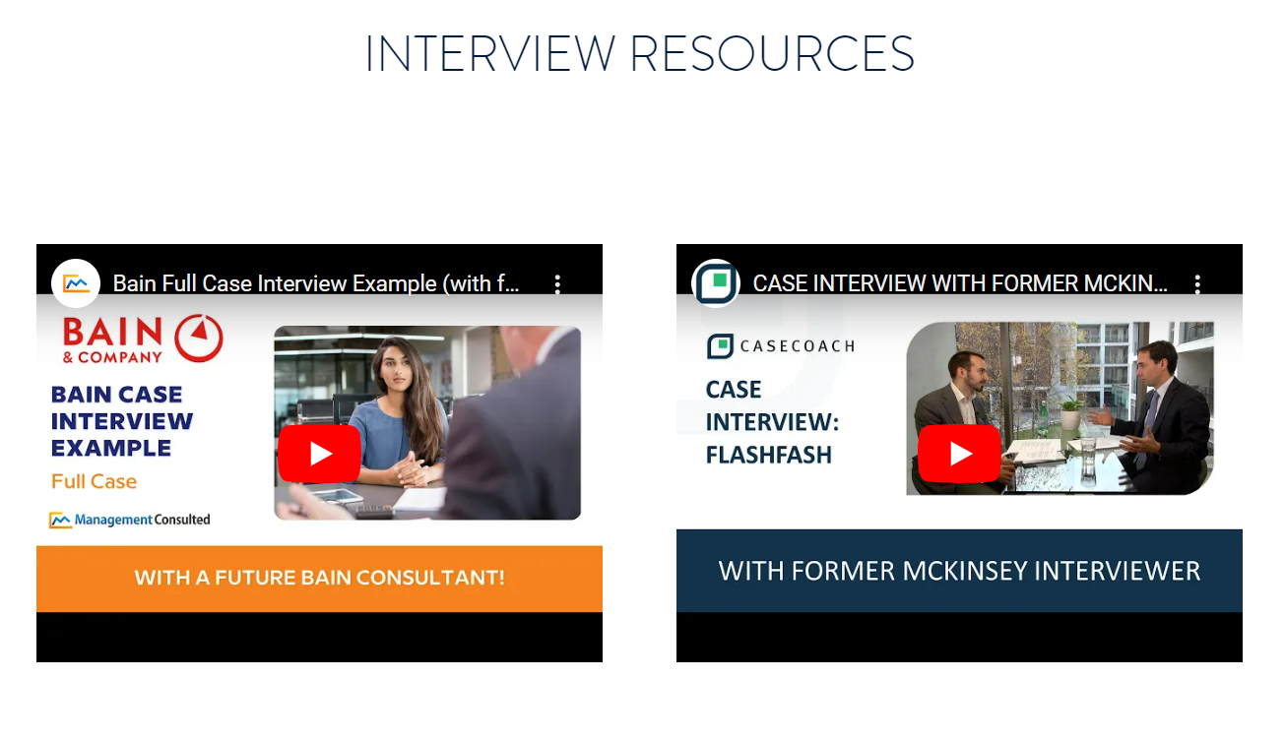
Additional Resources
Case Interview Tips
SCNO Website (Recruitment Tab)
Notes:
Emma

Slide 34
Application
Notes:
Emma

Slide 35
Recruitment Process
Info Night
About Us and Case Workshop
First Round Interviews
Two Interviews, 8 Minutes each, with Behavioral & Brainstorm Questions
*Final Round Interviews*
20 Minute Case Interview
January 21st
7:00 PM
January 24th
11:59 PM
January 27th
12:30 PM - 7:00 PM
January 29th
5:00 PM - 7:00 PM
January 30th
1:00 PM – 6:30 PM
Application Deadline
Available at illiniscno.org and in our Instagram bio
*Pre-Night*
Networking and Social
*Invite Only
Notes:
Bridget
*note that brainstorm question in not a case, but rather a business question to

Slide 36
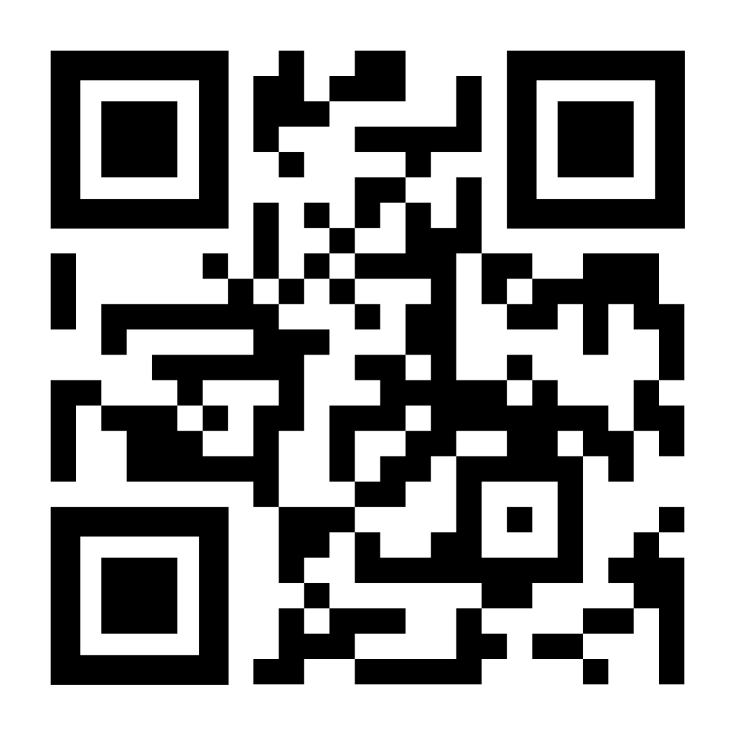
Application – Due This Saturday (Jan 24th) at 11:59pm
Scan this QR Code for our application!
Instagram Bio
SCNO Website under Recruitment
In Your Email
*Email us @recruitment.marketing@illiniscno.org with questions*
Notes:
Bridget
*note that brainstorm question in not a case, but rather a business question to

Slide 37
Thank you for coming!

Slide 38
Consulting With Purpose
Please use this QR code to fill out the sign-in form
Notes:
updated

